Slide 1
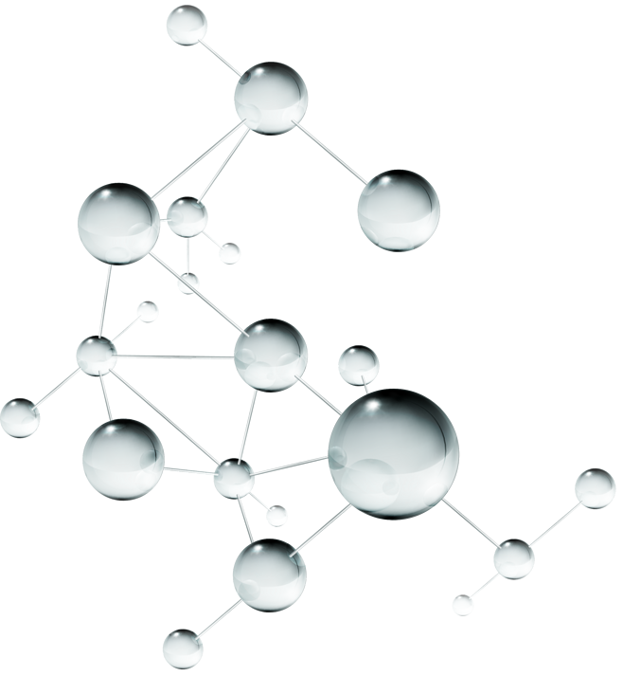

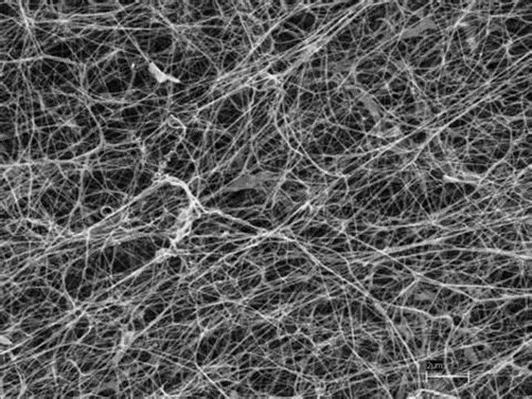
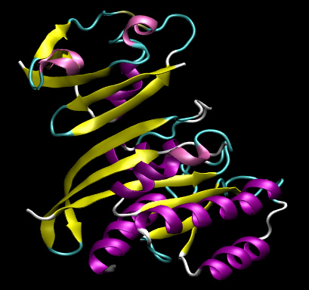
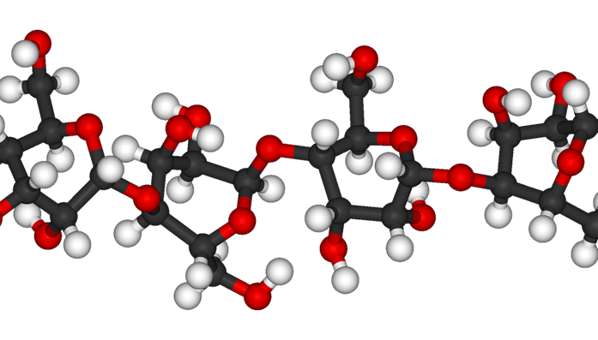
The Van der Waals and Electrostatic Interaction
Studying of
Crystalline Cellulose Iβ Based on Molecular Dynamics
——Xue-Wei Jiang, Hong-Hui Zhang, An-Hua Zhong

Slide 2
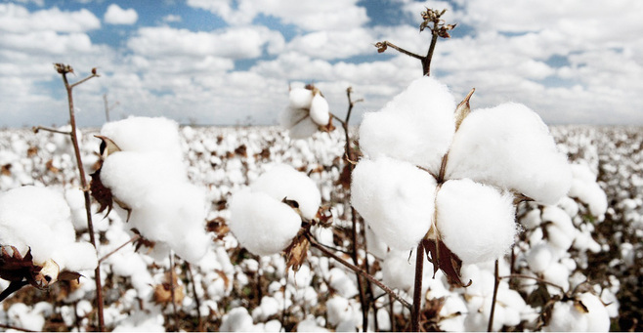
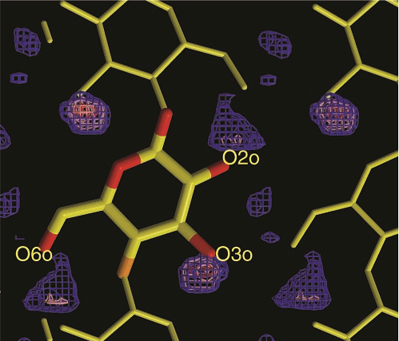
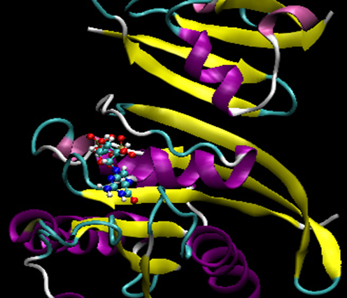
1
01.Background
02.Methodology and Processing
03.Results and discussions
04.Forecast
Molecular dynamics
Materials
Interactions
Cellulose Iβ
Cellulose fibers are
important mature of textile
and other materials
Hydrogen bonding is the main
binding forces between chains,
it is not all for stacking sheet
Molecular dynamics approach is
an effective computer modeling
technology

Slide 3

2
01.Background
02.Methodology and Processing
03.Results and discussions
04.Forecast
Building the initial structure
with cellulose-builder
Calculate the interaction energy by program
MMPBSA.py of AmberTools
All simulation were performed with
Amber software and explicit water

Slide 4


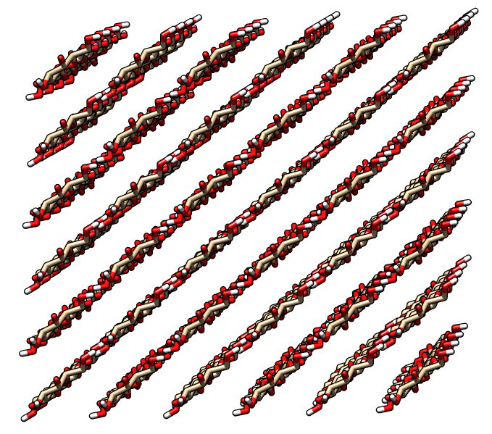
3
01.Background
02.Methodology and Processing
03.Results and discussions
04.Forecast
About the initial modeling
a = 7.784 Å,b = 8.201 Å,
c = 10.38 Å
α = β = 90°,γ = 96.5°
c is the chain direction

Slide 5


4
01.Background
02.Methodology and Processing
03.Results and discussions
04.Forecast
Step.04
Firstly heat the system with restraints.
Then run MD Equilibration
Run molecular
dynamics
Firstly the water was minimized.
Then the whole system.
Step.03
The two stages of
minimization procedure
Step.02
A 12Å buffer of TIP3P water around
the cellulose Iβ in each direction
Set the periodic
boundary condition
Various temperatures:298K,350K,
400K,450K,500K,550K
Force field:GLYCAM-06
Step.01
Set the initial environment
The simulation processing with software Amber

Slide 6

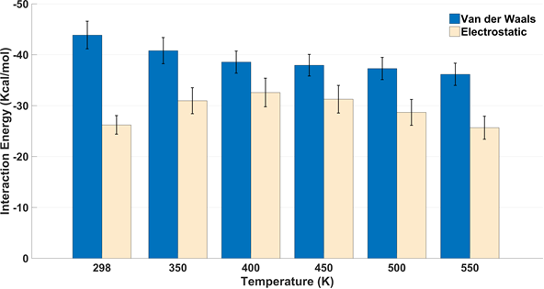
5
01.Background
02.Methodology and Processing
03.Results and discussions
04.Forecast
At 298 K, the Van der Waals and
electrostatic intermolecular energy per chain are -43.91 kcal/mol and -26.24 kcal/mol respectively. The Van der Waals energy gradually reduces when the temperature rises, meanwhile
the electrostatic energy increases initially and then decreases.

Slide 7
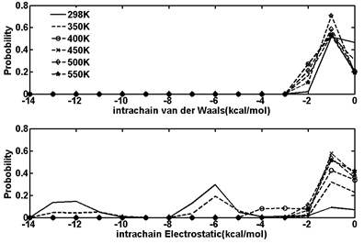
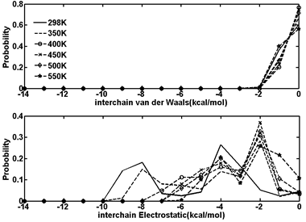
6
01.Background
02.Methodology and Processing
03.Results and discussions
04.Forecast
The electrostatic energy of most glucose residues for intrachain lies on 11-14 kcal/mol and 5-8 kcal/mol, while located on 7-10 kcal/mol and 2-5 kcal/mol at 298 K for interchain. The Van der Waals interaction energy in intrachain increases slightly as the temperature rises and there is almost no growth for interchain.

Slide 8
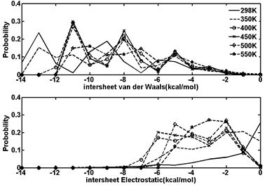
7
01.Background
02.Methodology and Processing
03.Results and discussions
04.Forecast
The intersheet Van der Waals interaction decreases slightly with the temperature increasing, The Van der Waals energy of most glucose residues is located on the range of 6-12 kcal/mol at 550 K.

Slide 9

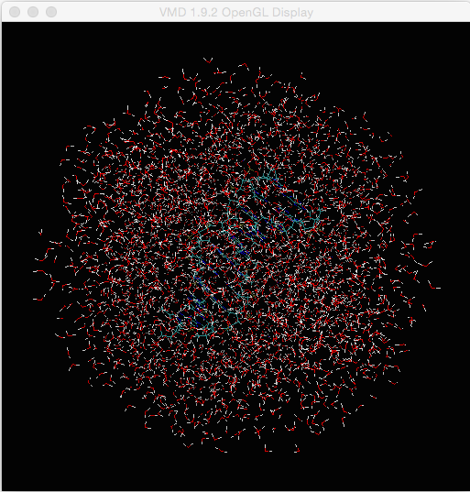
8
01.Background
02.Methodology and Processing
03.Results and discussions
04.Forecast
The interactions were discussed only in water, and no comparison to other solvents. In the next step, we will study the Van der Waals and electrostatic interaction in different solvent environments.

Slide 10
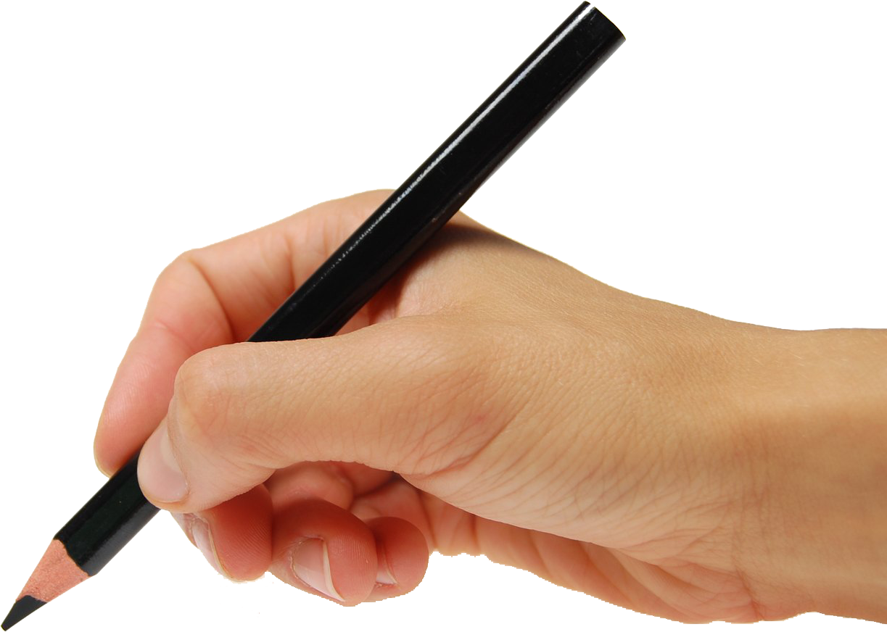
THANK YOU .
Notes:
模板来自于 http://docer.wps.cn

